Slide 1

PYTHON PROGRAMMING
Expense Tracker
Project 2 — Industrial Training Kit Documentation
Presented by
Alina Mehmood
Batch 2026 • Powered by DecodeLabs

Slide 2

Introduction
Stepping into the role of a Python Developer at DecodeLabs
Project 2 moves beyond simple arithmetic into Data Accumulation — the foundation of every real financial system.
The task: build a script where a user repeatedly enters expense amounts, and the program continuously stores, updates, and totals them in real time.
Mastering this pattern proves the ability to handle continuous data entry through disciplined mathematical and programmatic logic — a core skill before attempting complex financial software.
Why It Matters
Every backend system — from banking apps to e-commerce carts — relies on the same idea:
reliably keep a running total as new data arrives.
Completing this project unlocks the next milestone in the DecodeLabs Industrial Training track.
DecodeLabs | Python Programming — Project 2
2

Slide 3



Project Objective
Goal
Create a script where the user enters multiple expense amounts (e.g. 100, 50, 20). The program continuously adds each value and displays the final Total Spent.
Key Skill
Core Concept
Why It Matters
Mathematical operations and the Accumulator Pattern — repeatedly adding a new value to a running total (total = total + new_expense).
Data accumulation and state preservation: keeping a value alive and updated across every loop cycle instead of resetting it.
Essential groundwork for data processing and calculation logic used throughout backend and financial software engineering.
DecodeLabs | Python Programming — Project 2
3

Slide 4




System Blueprint: The IPO Model
Input → Process → Output — the universal structure of every backend program
1. Input — The Gate
2. Process — The Engine
3. Output — The Display
→
→
The program continuously requests raw expense values from the user, one entry at a time.
Each value is validated, converted to a number, and added to a running total using the accumulator pattern.
Once entry ends, the final accumulated total is displayed clearly as the result.
Golden Rule: Garbage In = Garbage Out — unvalidated input corrupts every stage downstream.
DecodeLabs | Python Programming — Project 2
4

Slide 5
Core Logic: The Accumulator Pattern
The heartbeat of the ledger — how the program remembers and updates state
Two Building Blocks
State Growth Example
A. Initialization (Memory)
total = 0
A variable (e.g. total) is set to zero before any looping begins — the starting point of the ledger.
+ 5 → total = 5
+ 10 → total = 15
B. Iteration (Continuous Update)
On every loop cycle, the new expense is added to the existing total, and the updated value is kept alive for the next cycle.
+ 20 → total = 35
+ 50 → total = 85
Critical distinction: the total must live OUTSIDE the loop. If it is reset inside the loop, every past entry is silently discarded — a common logic error.
+ 100 → total = 185
Final Result: $185.00
DecodeLabs | Python Programming — Project 2
5

Slide 6

Input Validation & Defensive Coding
Treating user input as untrusted until proven otherwise
Type Conversion
Error Handling
All input arrives as text by default. Numbers entered by the user must be explicitly converted before they can be added — otherwise the program joins text instead of performing arithmetic, producing an incorrect result.
If the user enters something that is not a valid number, the program should catch that error gracefully, display a clear message, and continue running instead of crashing.
Defensive Coding Checklist
Validate every input before using it in a calculation
Convert text input to a numeric type explicitly
Handle invalid entries without stopping the program
Never trust that input matches the expected format
DecodeLabs | Python Programming — Project 2
6

Slide 7


Program Flow: Loop & Graceful Exit
Repeating entry safely, and knowing when to stop
Continuous Loop
Sentinel Value
Graceful Shutdown
The program repeatedly asks for a new expense entry, allowing an unlimited number of transactions in a single run.
A special command (such as typing "done" or "quit") signals the program to stop asking for more input.
When the sentinel is detected, the loop ends cleanly and control passes to the output stage — no abrupt crash.
Without a defined stopping condition, the loop runs forever. Every continuous-entry program needs a clear, well-communicated exit path.
DecodeLabs | Python Programming — Project 2
7

Slide 8
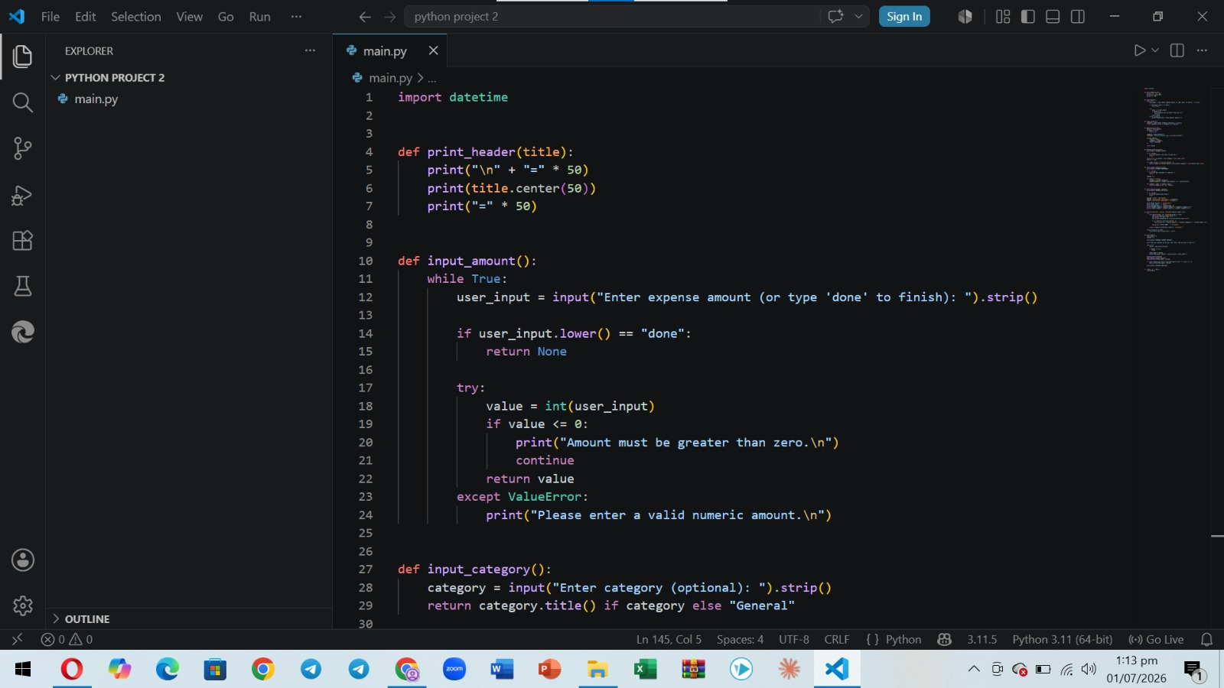

Slide 9
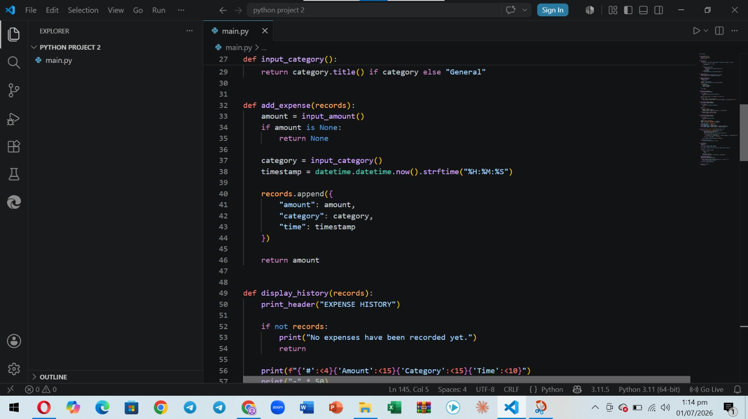

Slide 10
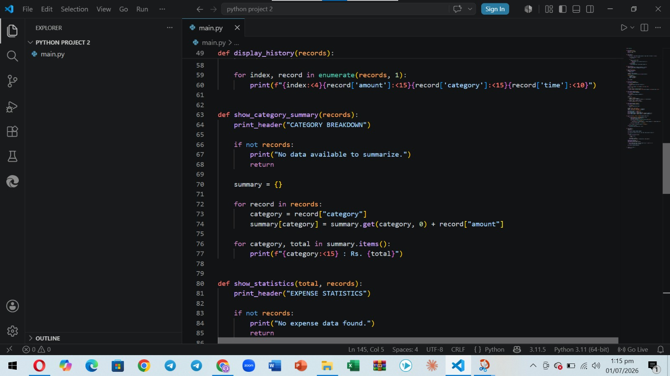

Slide 11
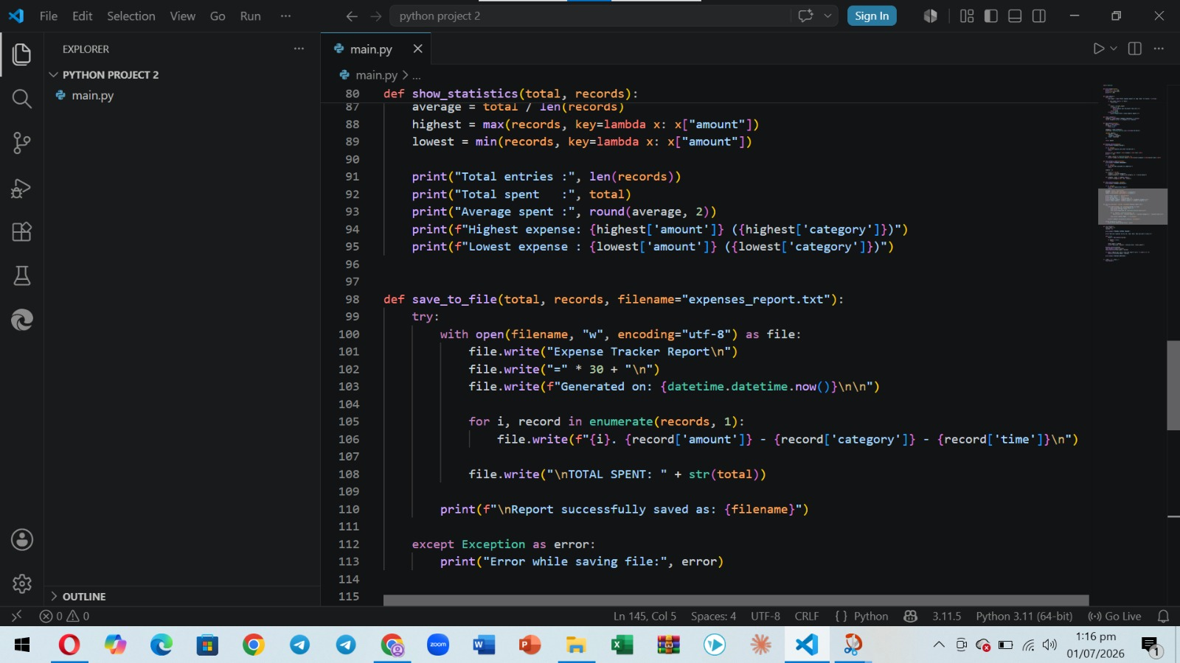

Slide 12
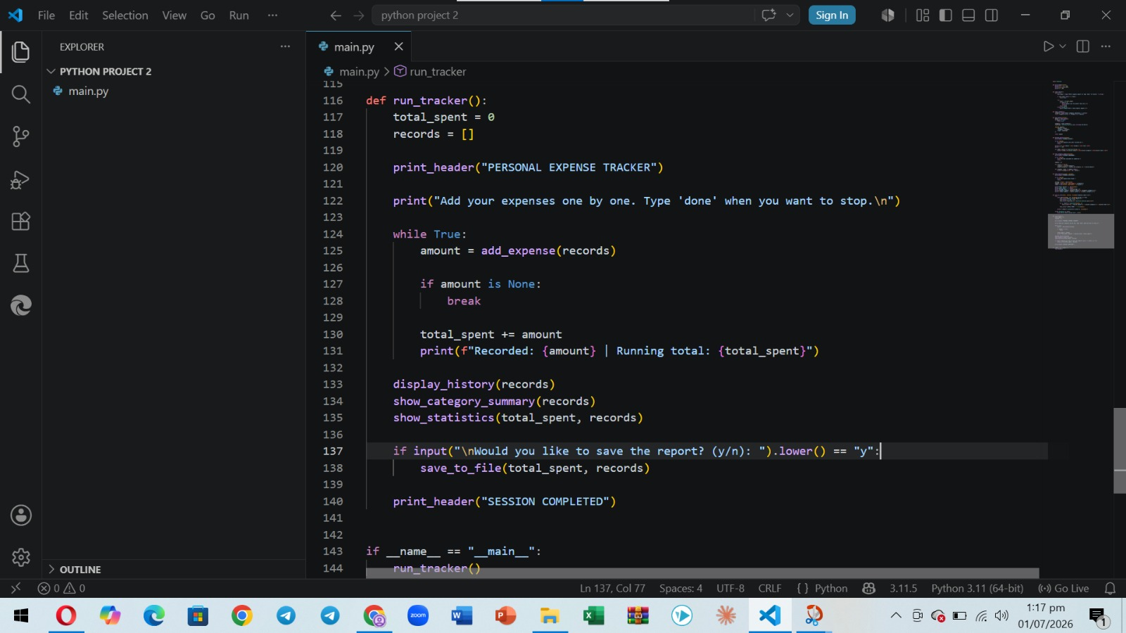

Slide 13
The Quality Standard
Audit checklist used to verify project completion
Stability
State Integrity
Defense
Control
Program correctly handles five or more sequential transactions without error.
The total variable is initialized outside the loop and preserved correctly across cycles.
Invalid input is caught and handled without crashing the program.
A clear exit command stops the loop and prints the final accumulated total.
AUDIT REQUIRED — All four criteria must pass before Project 2 is marked complete.
DecodeLabs | Python Programming — Project 2
8

Slide 14
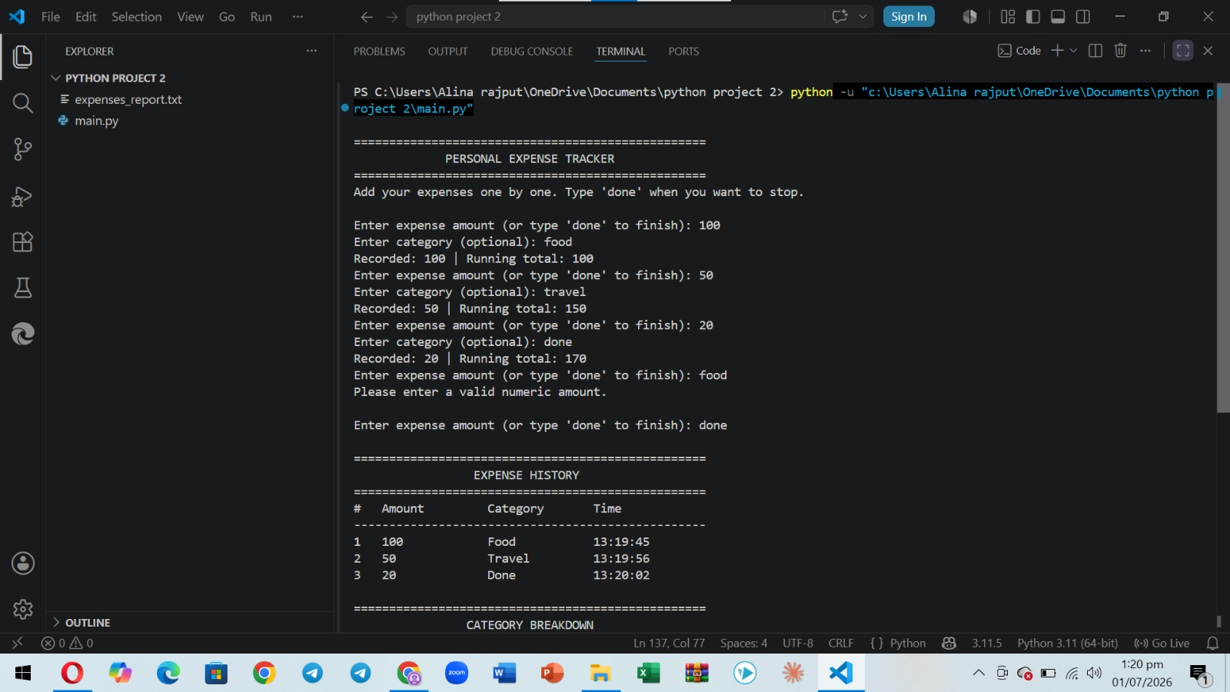

Slide 15
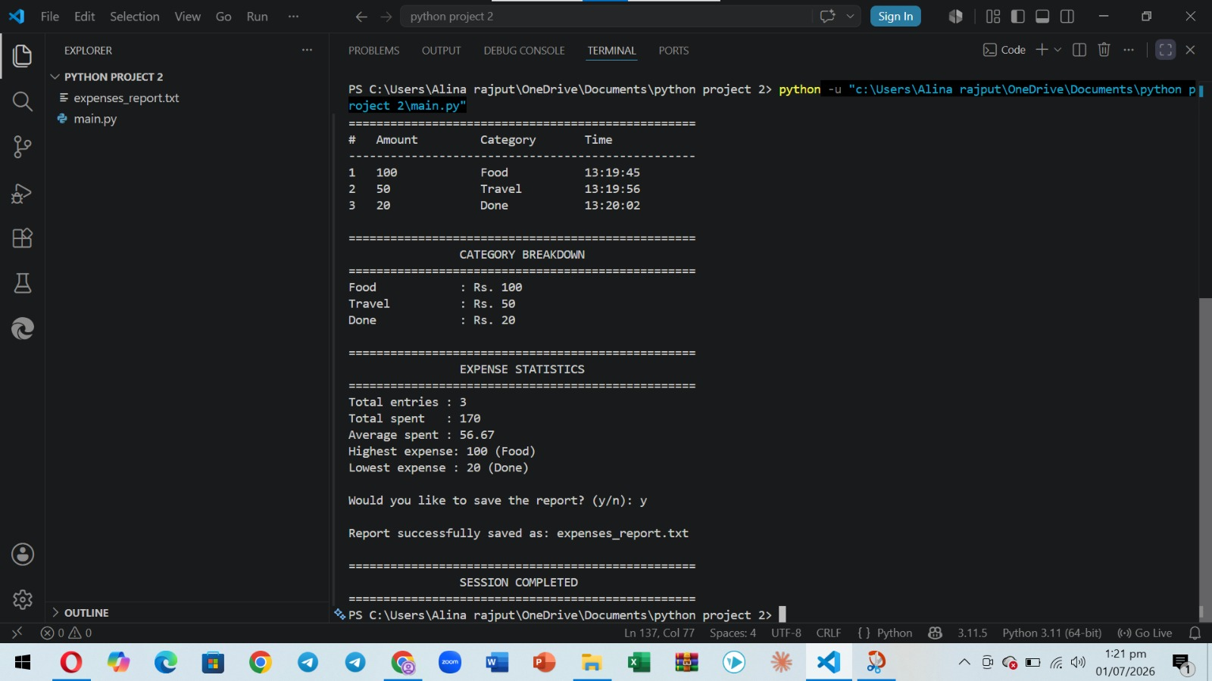

Slide 16
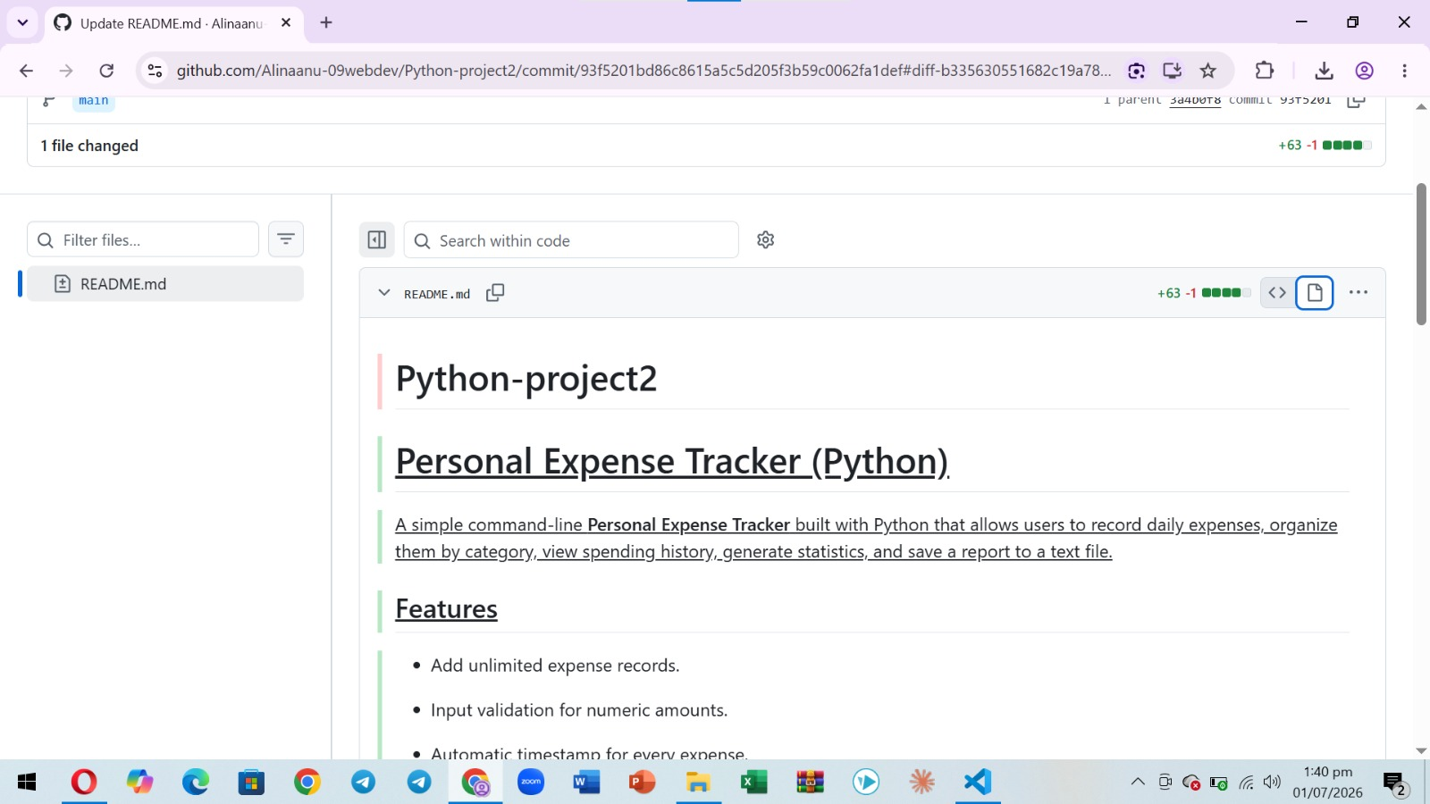

Slide 17
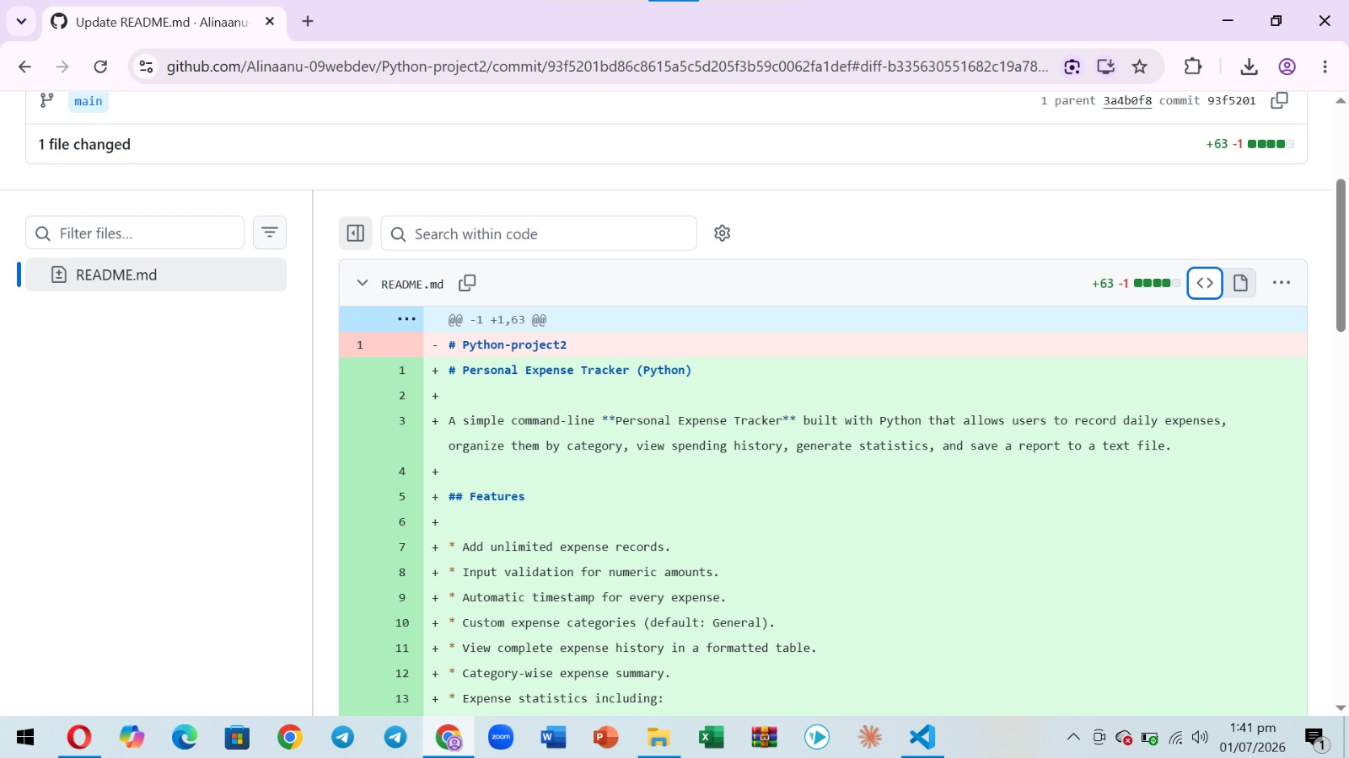

Slide 18
Conclusion
Mastering Python is achieved through hands-on practice, not theory alone.
Each project should be approached individually — experimenting with unique solutions and treating every logic error as a learning opportunity.
Completing these milestones at DecodeLabs builds a real-world portfolio that demonstrates backend thinking to future employers.
The journey to becoming a professional developer begins with the very first line of code written today.
Key Takeaways
Accumulator pattern = running total
Always validate before you calculate
Loops need a graceful exit
State must persist outside the loop
Test with 5+ real transactions
DecodeLabs | Python Programming — Project 2
9

Slide 19
Thank You
Presented by Alina Mehmood
decodelabs.tech@gmail.com • www.decodelabs.tech
Greater Lucknow, India

